Slide 1


Intelligence
Structured Products
SEBI Registered Investment Advisors Registration No. INA200014548 Type of Registration- Non-Individual, Validity of Registration- Perpetual,
Please note: Certain elements of the solutions mentioned in this document may not be offered from Unien Capital Advisors Pvt Ltd.

Slide 2


Structured Product?
A structured product is an unsecured obligation of an issuer with a return, generally paid at maturity, that is linked to the performance of an underlying asset.
The return of a structured product will depend on the performance of the underlying asset and the specific features of the investment.
Features and risks of structured products can affect terms at issuance, returns at maturity and the value of the structured product before maturity.
Structured products may have limited or no liquidity before maturity.
Before investing, you should understand the unique risks and features associated with structured products
Based on?

Slide 3

Underlying
Of a structured product
The return of the underlying asset is a reference for determining the return on a structured product. You may have exposure to some, all or none of the upside or downside performance of the underlying asset at maturity depending on the features of the investment.
When purchasing a structured product you are not investing directly in the underlying asset (although certain structured products may result in your owning the underlying asset at maturity). The underlying asset can be any of the following:
    – A stock
    – A commodity
    – An index
    – An interest rate
    – A foreign exchange rate
    – Other investable assets or market measures
    – A combination of any of the above
Notes:
edited

Slide 4
Risks
Of a structured product
Credit Risk
A structured note is issued as an obligation of a corporate issuer. Because the note or warrant is not backed by any collateral, any payment on these structured products, including any repayment of principal and any feature reducing downside market risk, depends solely on the ability of the issuer to pay.
If the issuer is bankrupt or is otherwise unable to pay its obligations as they come due, you may lose some or all your investment in the structured product.
Market Risk / Other Risks
The payment on a structured product is economically similar to a combination of a bond with one or more options or derivative instruments. Therefore, when a structured product is created, its terms and features are based on factors that can affect the pricing of bonds and options.
Other risks include tax and regulatory changes, liquidity risk, reinvestment risks etc.
Notes:
edited

Slide 5
Types
Of a structured product
Preserve
Capital
Capital Preservation strategies are designed to complement and provide potential to outperform traditional fixed income investments. At maturity market downside risk is limited by the capital preservation feature, but investors must be willing to bear downside market risk prior to maturity.
Enhanced Yield strategies may provide investors the opportunity to generate yields higher than prevailing rates in traditional fixed income products. Investors potentially face the full downside market risk of the underlying asset or assets, however downside market exposure may be reduced by a contingent protection feature at maturity.
Enhanced
Yield
Enhanced Participation strategies provide investors with upside market exposure which may be limited by a maximum gain, or provide uncapped participation in the performance of the underlying asset. Strategies may have full downside market exposure, or they can be structured with features that may reduce downside market exposure at maturity.
Enhanced Participation
Notes:
edited

Slide 6
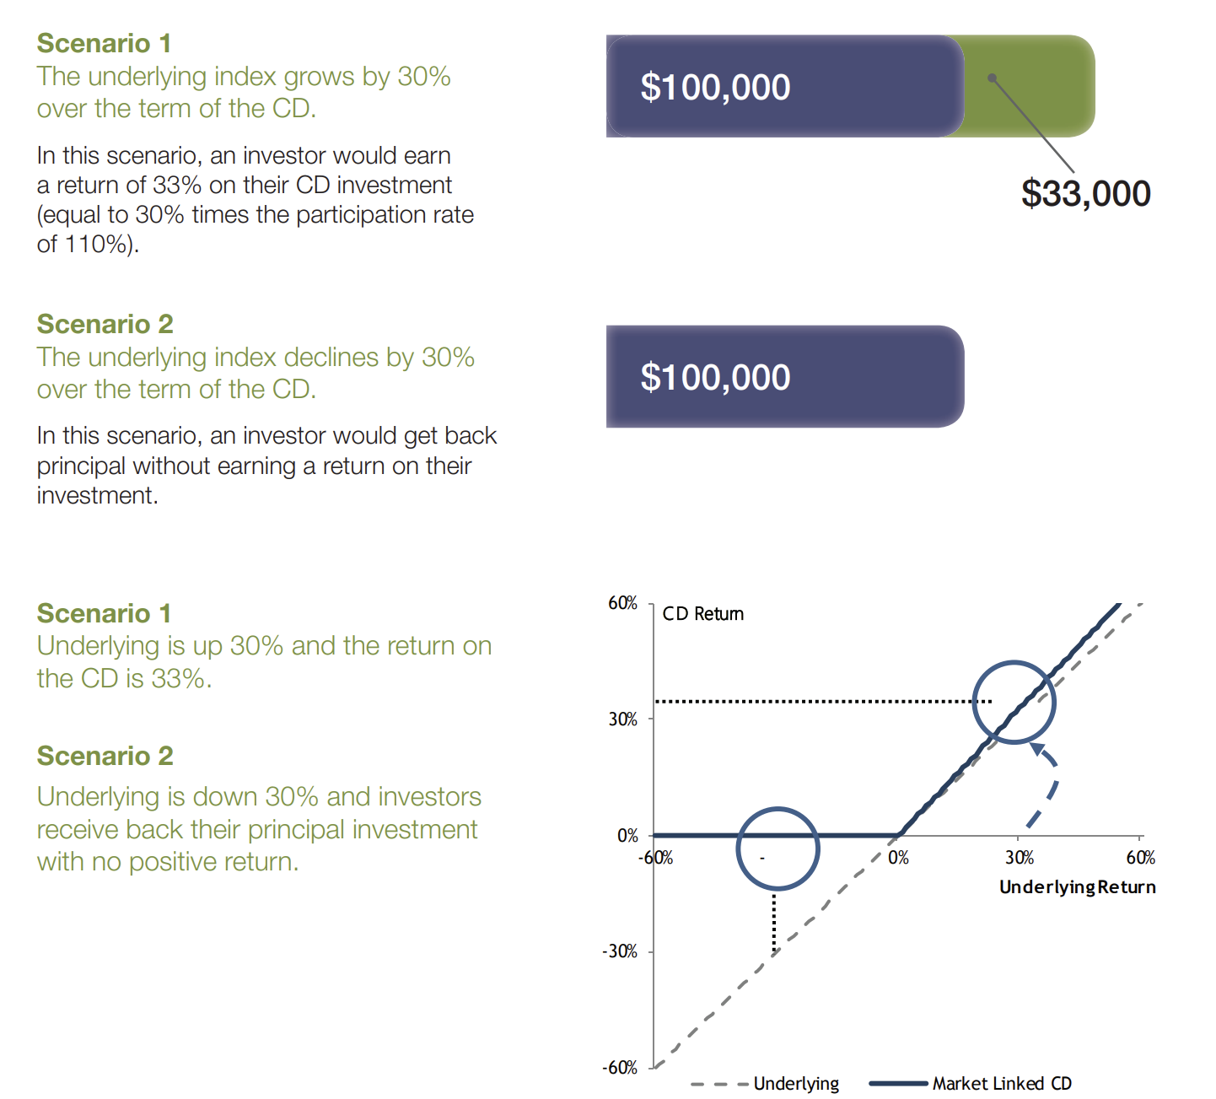
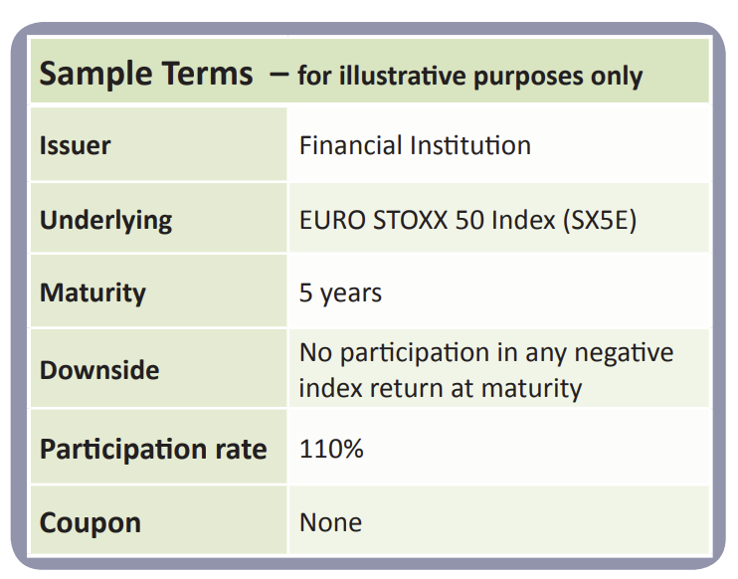
Preserve Capital

Slide 7
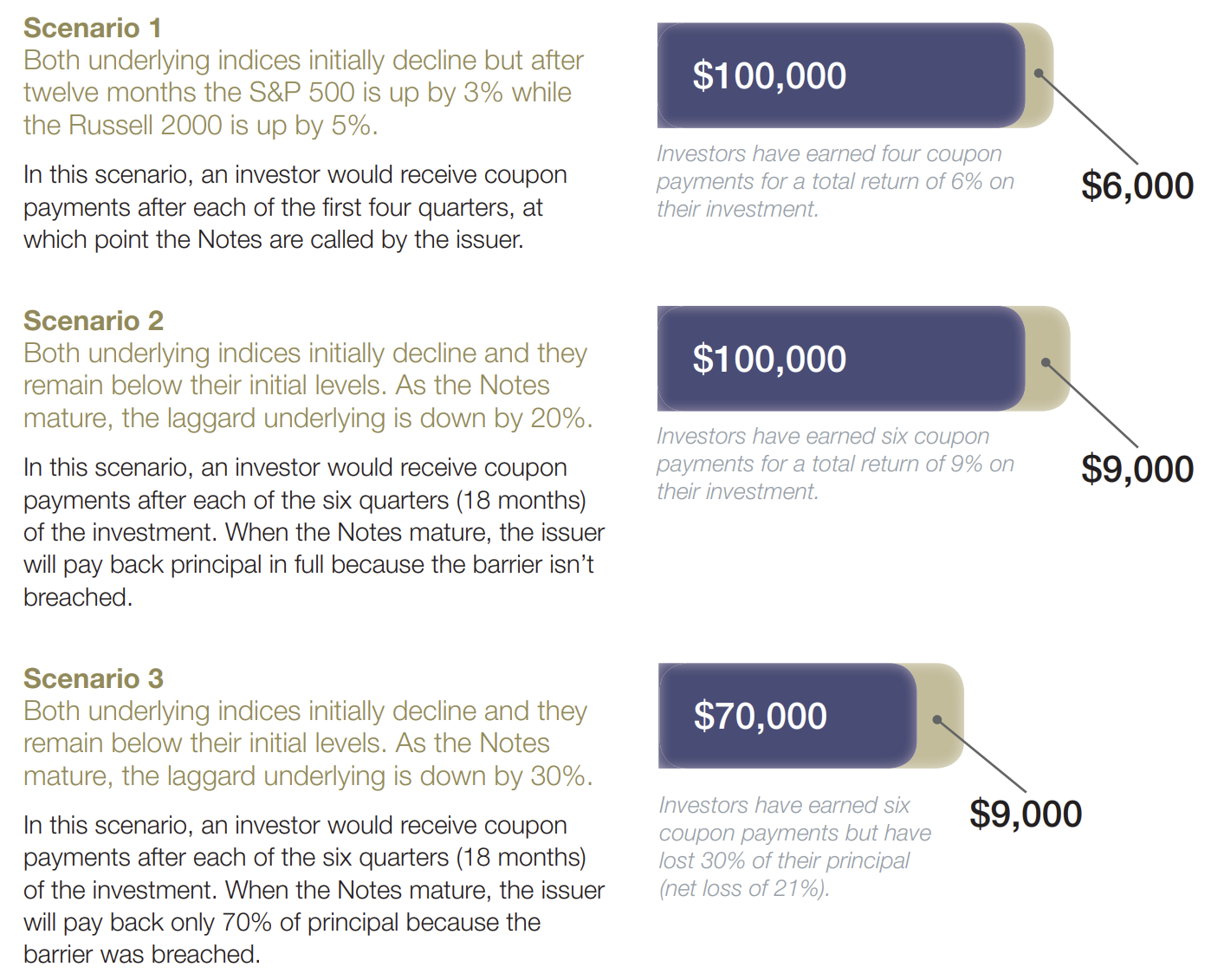
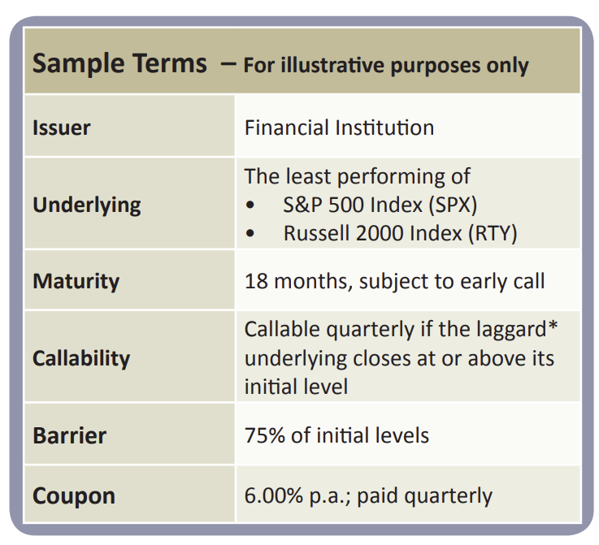
Enhance Yield

Slide 8
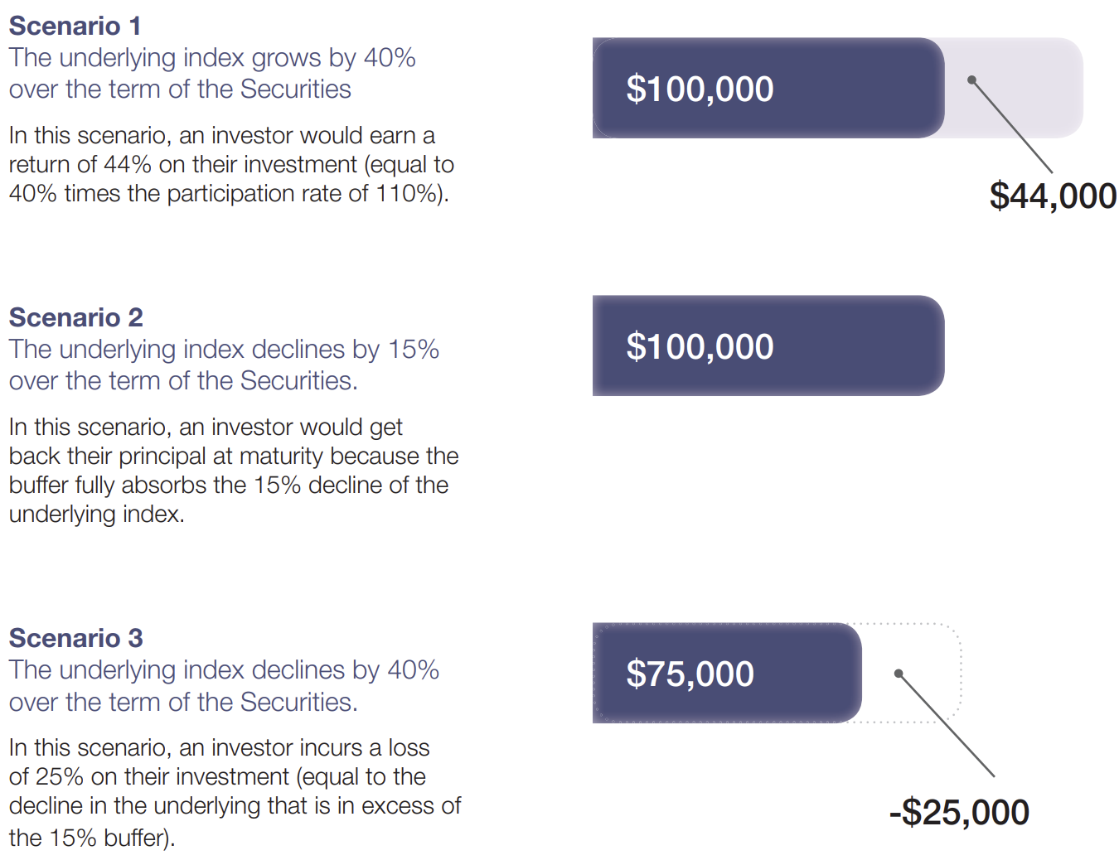
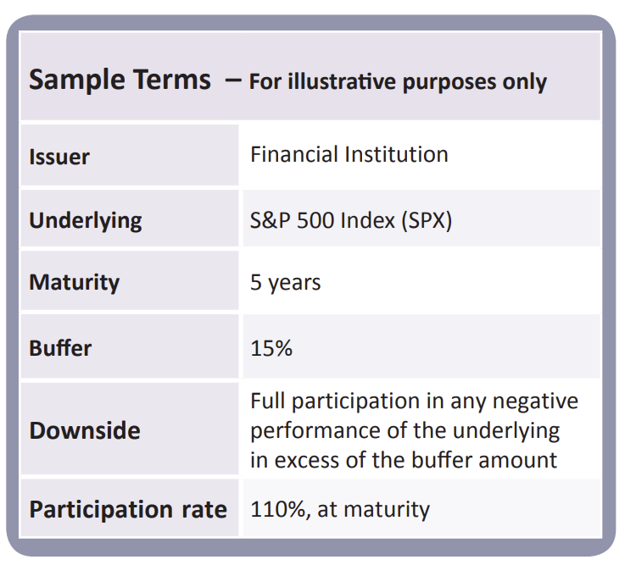
Enhance
Participation

Slide 9



Key Issuers of Structured Products - India
Abans Global
Anand Rathi
Edelweiss / Nuvama

Slide 10
Structured Products - India
Product Name | Return Scenario | Entry dates | Exit Dates | Avg Nifty Price
Twin Win | Fixed Returns and Principal Protection: Fixed Returns of 6.00% p.a. payable at maturity If Nifty 50 Index gives more Than 6.00% p.a. returns over 3 years, Twin Win gives Nifty 50 returns# In case Nifty is down after 3 years, you still get Principal + Fixed return | 24 Dec 2024, 30 Jan 2025, 27 Feb 2025, 27 Mar 2025, 24 Apr 2025, 29 May 2025 | 29 Jul 2027, 26 Aug 2027, 30 Sep 2027, 28 Oct 2027, 25 Nov 2027, 30 Dec 2027 | 23174
Nifty AWE | Absolute return of 50% if Nifty goes up by 10% With Principal Protection | 20 Feb 2025, 27 Mar 2025, 24 Apr 2025, 29 May 2025 | 30 Sep 2027, 28 Oct 2027, 25 Nov 2027, 30 Dec 2027, 27 Jan 2028, 24 Feb 2028 | 22913.5
Nifty Beta | 150% of underlying NIFTY index performance on the upside. Downside equivalent to Nifty Index | 26 Dec 2024, 30 Jan 2025, 27 Feb 2025, 27 Mar 2025, 24 Apr 2025 | 26 Aug 2027, 30 Sep 2027, 28 Oct 2027, 25 Nov 2027, 30 Dec 2027 | 23181.58
Midcap PP | 1x of Midcap select index upside with Principal Protection downside | 27 Jan 2025, 27 Feb 2025, 27 Mar 2025, 24 Apr 2025, 29 May 2025, 26 Jun 2025 | 26 Aug 2027, 30 Sep 2027, 28 Oct 2027, 25 Nov 2027, 30 Dec 2027, 27 Jan 2028 | 11339.75
LEAP AWE PP | Absolute return of 56% if LEAP goes up by 10% or more return with Principal Protection Downside | 20 Feb 2025, 27 Mar 2025, 24 Apr 2025, 29 May 2025, 26 Jun 2025, 31 Jul 2025 | 30 Sep 2027, 28 Oct 2027, 25 Nov 2027, 30 Dec 2027, 27 Jan 2028, 24 Feb 2028 | 1398.25

Slide 11
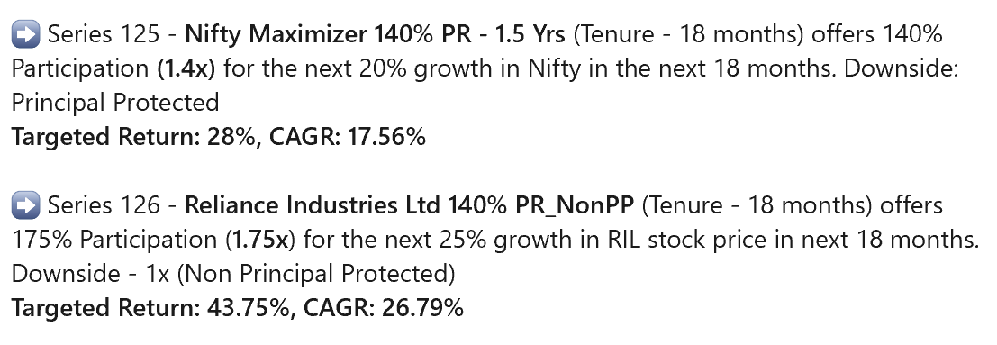
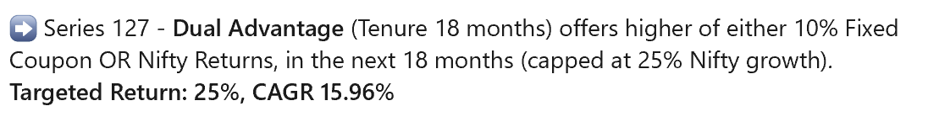
Structured Products - India

Slide 12
Peace of Mind
Thank you
Confidential: This communication contains privileged or confidential information and maybe otherwise protected by work product immunity or other legal rules. If you are not an intended recipient of this communication, but have received the communication in error, please delete the communication and do not act upon, print, disclose, retain a copy, forward or redistribute the email or any portion of the email. This communication does not constitute an offer to sell or a solicitation of an offer to purchase any interest in any investment vehicles managed by Unien Capital. Unien Capital does not provide tax, accounting, or legal advice to our clients, and all investors are advised to consult with their tax, accounting, or legal advisors regarding any potential investment.

